Slide 1
Azure Go to Market

Slide 2
Getting Started with Azure
Go to Market
Join Azure Mentor Program
Invest, win, and learn from your first few customers
Create solution bundles your team can sell:
Start with Augmenting existing offerings - Identity, Backup, Site Recovery, Storage
Progress to Lift & Shift - extend the network, old server replacements, VMs / RDS / Websites
Now, Go big with marketing Assessments to land new & engage existing customers – leverage Azure Everywhere, BitTitan HealthCheck for Azure
Embrace Internally
Activate your Azure IURs
Learn the Key SMB Workloads
Get Certified
Build a plan & set internal goals
Take advantage of the Hands-On-Labs and Massively Open Online Courseware
Nominate a Champion
Dedicated Employee
Technical & Sales Skills
Conduit for External Information and Internal Questions

Slide 3
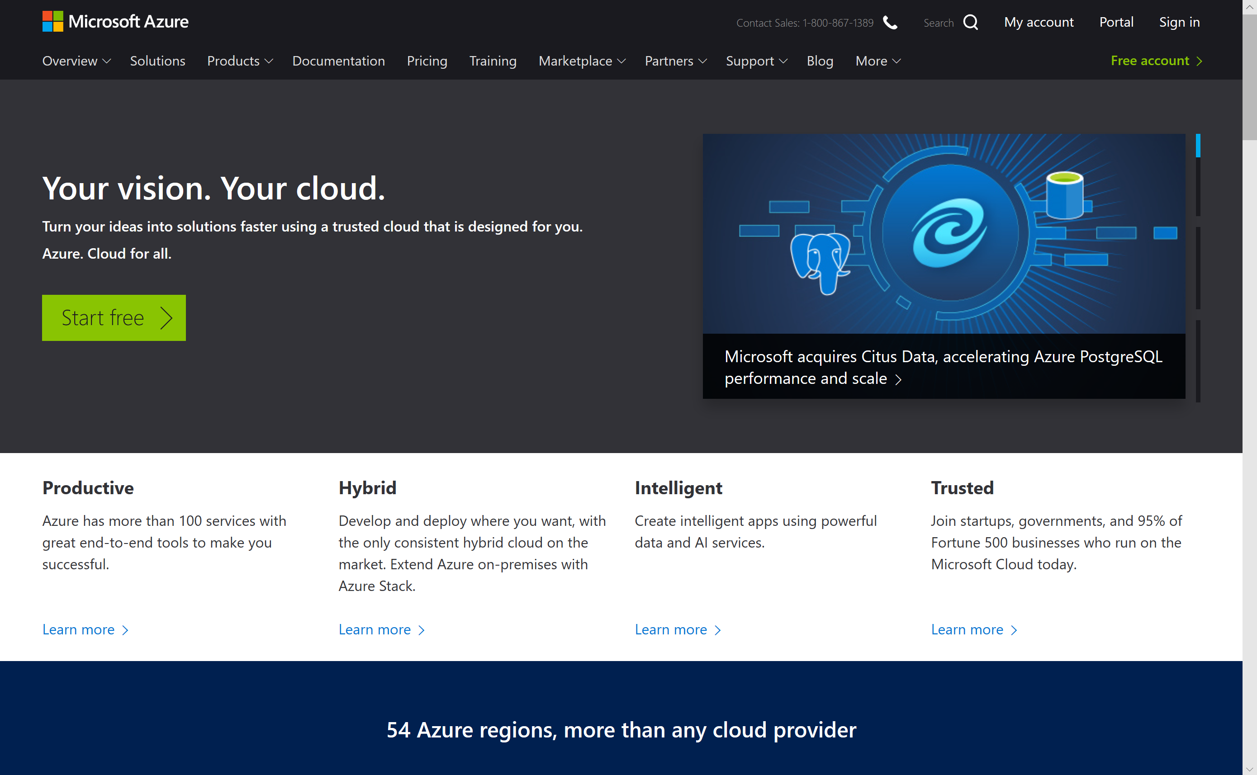
Azure.Microsoft.com

Slide 4
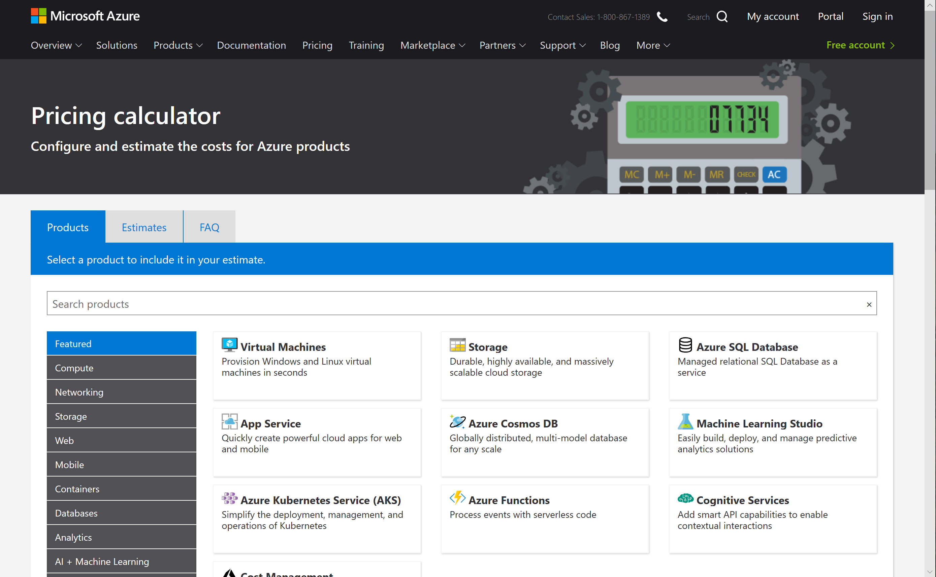
Azure Pricing Calculator https://azure.microsoft.com/en-us/pricing/calculator/

Slide 5
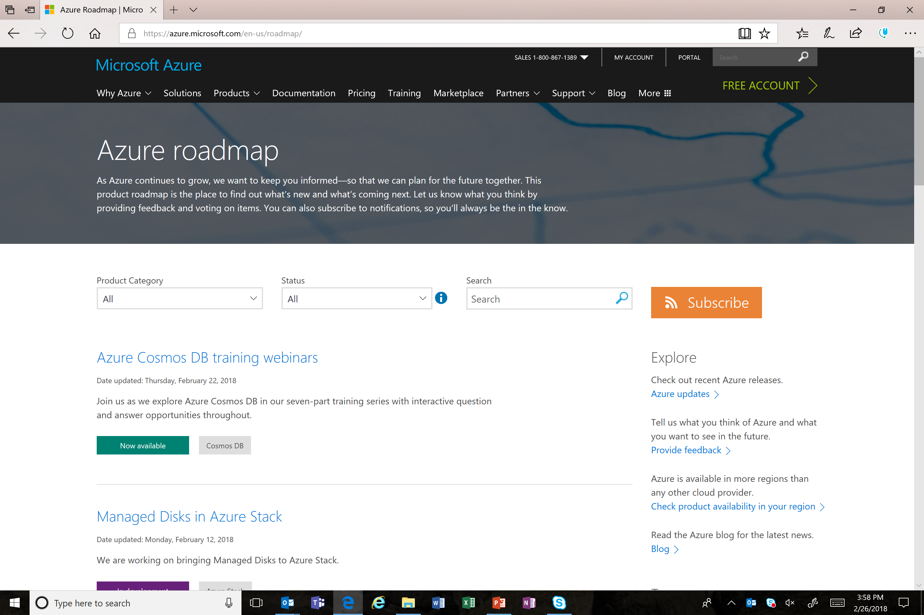
Azure.Microsoft.com/Roadmap

Slide 6
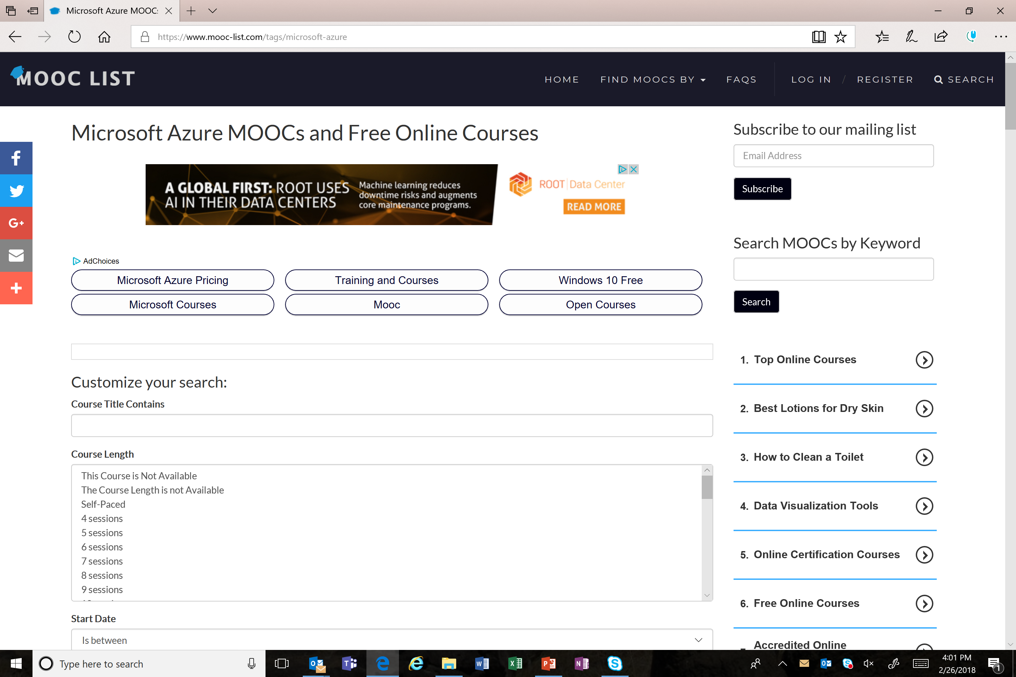
https://www.mooc-list.com/tags/microsoft-azure

Slide 7
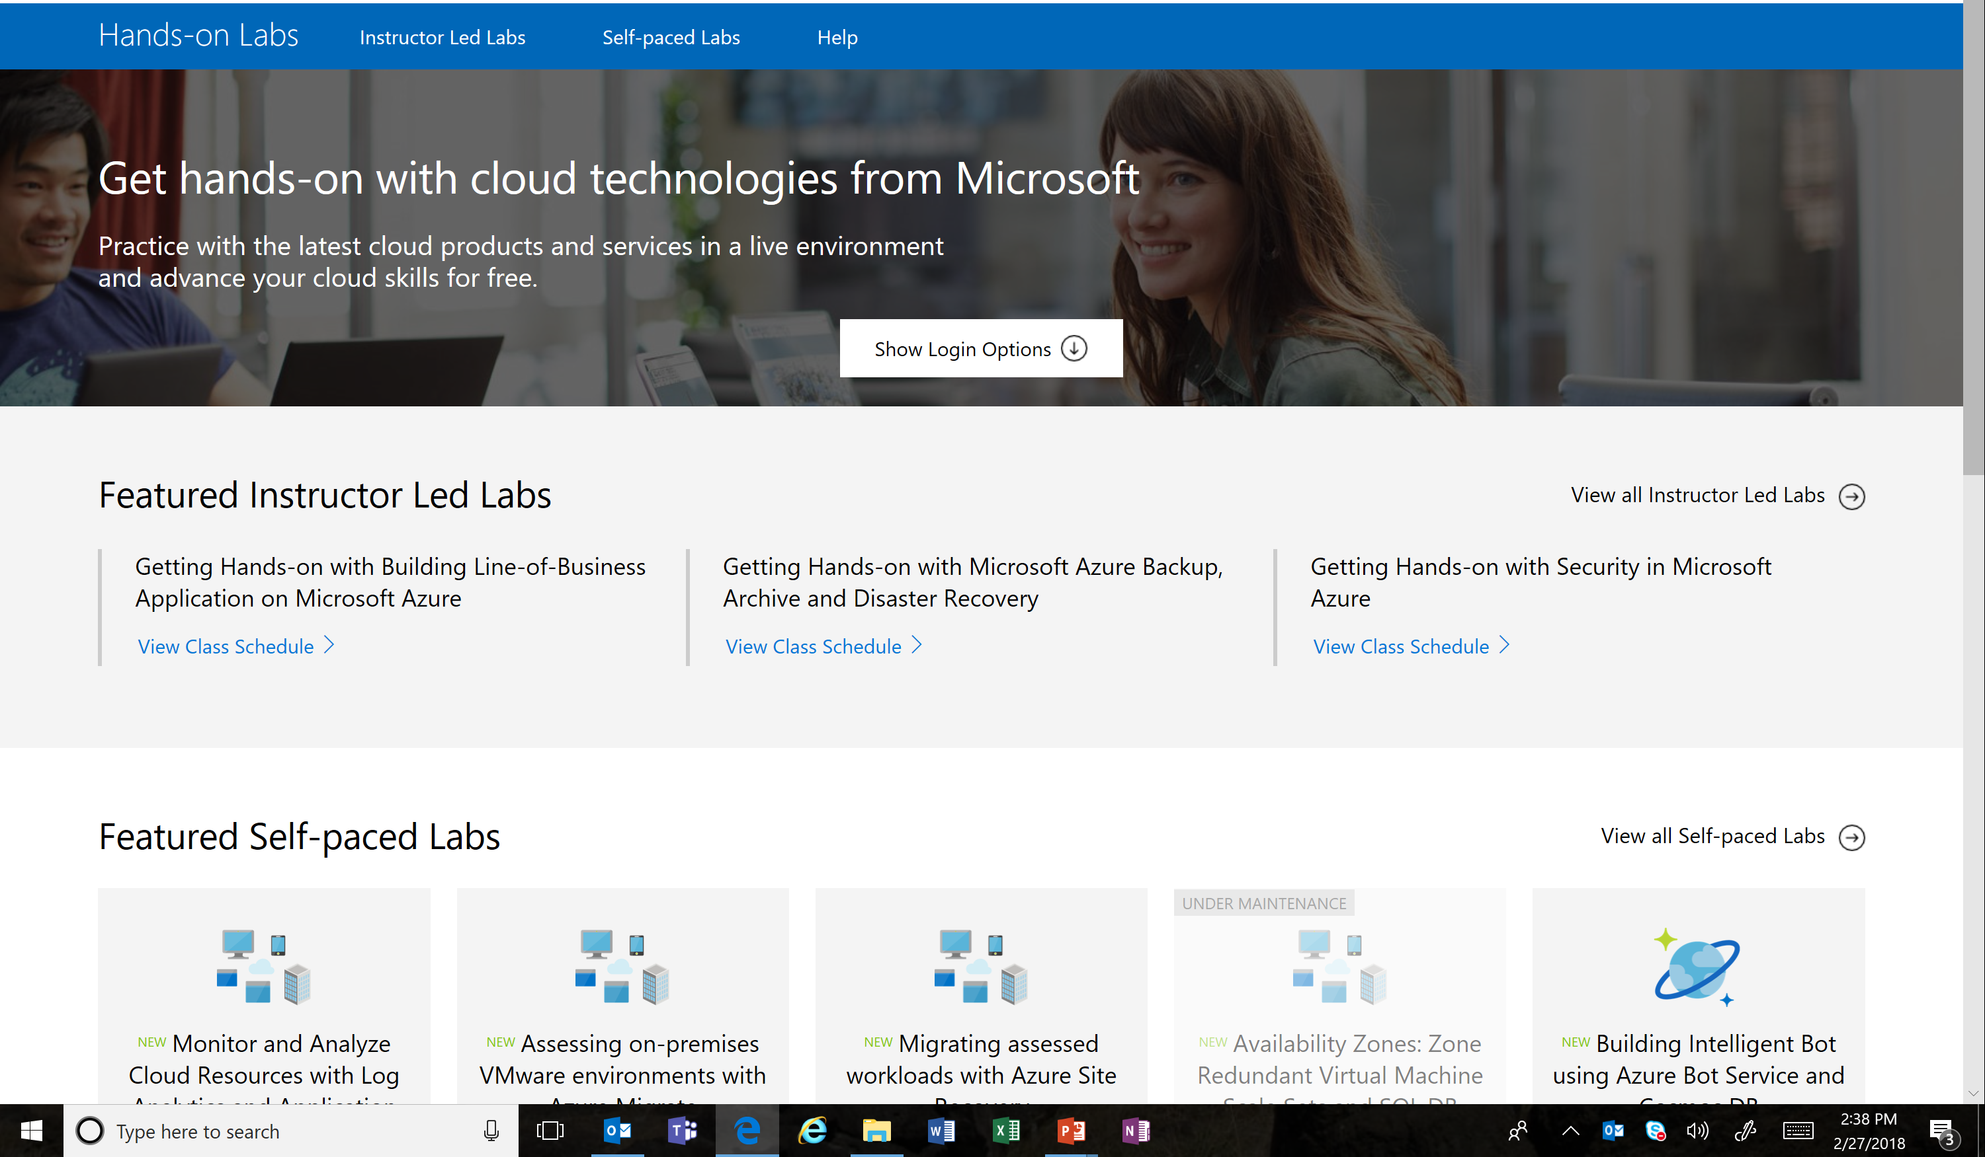
https://www.microsoft.com/handsonlabs

Slide 8
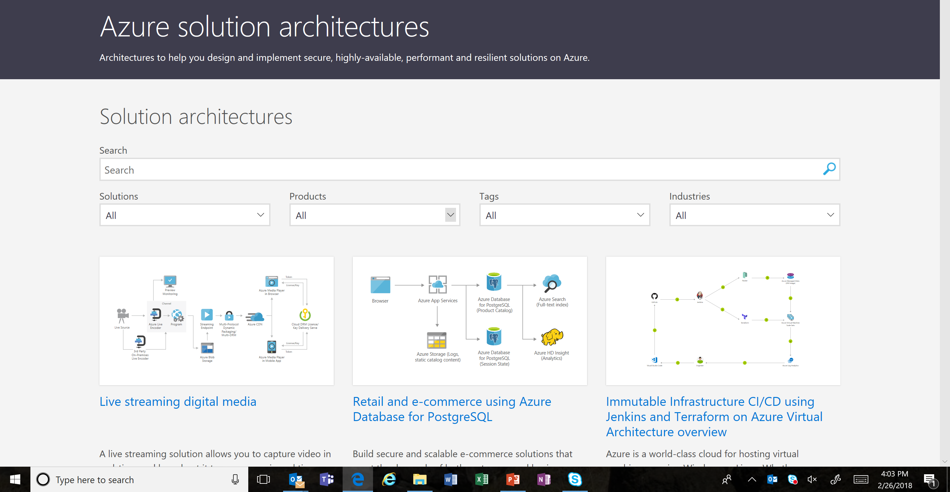
Azure Sample Architectures https://azure.microsoft.com/en-us/solutions/architecture/

Slide 9












Azure Migration Tools
Discover
Migrate
Optimize
Microsoft
Microsoft Assessment and Planning (MAP) Toolkit
Azure Migrate
Database Migration
Assistant
Azure Site
Recovery
Database Migration
Service
Operations
Management Suite
^{Public Preview}
Partners

Slide 10
Microsoft Partner Network Technical Benefits Structure
Cloud Performance
Competencies: Cloud Platform, Cloud Productivity, Cloud Customer Relationship Management, Small and Midmarket Cloud, and Enterprise Mobility Management
Hybrid
Competencies: App Dev, Collab & Content, Communication, Data Analytics, Data Platform, Datacenter, Dev & Deployment, Messaging, Mid Market Solution Provider, Project & Portfolio Mgmt, and CRM
On Premises
Competencies: All other
Gold
50 Partner Advisory Hours, Technical Presales Assistance, Partner Support Community
20 Product Support Incidents
20 Product Support Incidents
20 Product Support Incidents
Unlimited Signature Cloud Support Incidents
10 Signature Cloud Support Incidents
Silver
20 Partner Advisory Hours, Technical Presales Assistance, Partner Support Community
15 Product Support Incidents
15 Product Support Incidents
15 Product Support Incidents
Unlimited Signature Cloud Support Incidents
10 Signature Cloud Support Incidents
Action Pack
5 Partner Advisory Hours (with your first cloud sale), Partner Support Community
10 Product Support Incidents
Network
Partner Support Community
Online Interactive Sessions

Slide 11
Microsoft Partner Technical Services
Helping partners win more deals, accelerate deployment, increase consumption and support Microsoft solutions throughout every stage of your customer relationships.
Customer lifecycle
Sell
Deploy
Support
Win more deals through Partner focused business and technical consultation, and training:
Technical presales assistance
Accelerate the design & deployment phases, and drive consumption of solutions with technical content, advice and training:
Advisory Hours
Resolve technical roadblocks by engaging with our support teams to resolve problems:
Product support
Signature Cloud Support
Technical training
Microsoft partner online support resources
Partner Technical Services will set your business apart and help you succeed.
Additional support offerings
Advanced Support for Partners
Watch videos
Premier Support for Partners
Partner Technical Services are available through the MPN technical benefits structure, except for the Advanced Support for Partners (aka.ms/asfp) and Premier Support for Partners (aka.ms/premier) support offerings. Visit aka.ms/CoreBenefits, and for more information.

Slide 12


